Slide 1
Effects of carbon footprint
By
(Student’s name)
Class
Number
Institution

Slide 2
Introduction
Carbon footprint refers to the amount of carbon that is emitted by human activity either directly or indirectly (Menon, 2014).
The said activity could be executed by an organization, product, event and/or an individual.
According to Methu (2015) Carbon footprint is effective in the measurement of the effect of individuals, communities, industries or countries on the environment.
Measuring carbon footprint in turn, informs mitigation of the effects of global warming(Menon, 2014).

Slide 3
Ecological footprint measurements
Ecological footprint measurement provides the required biological capacity of the planet as a result of a specific human activity or population (Menon, 2014).
This is obtained by measuring the area of land and water that is biologically productive which an individual, community, organization, country or all humanity uses in the production of the resources they consume as well as absorb the waste generated (Methu, 2015).

Slide 4
Description of my current lifestyle and what informed my results
I take animal products frequently and red meat almost every day of the week.
I travel a lot and cover a distance of about 240km per week.
My house hold mostly consumes non-renewable energy.
My household produces more wastes as compared to my neighbours.

Slide 5
Results of my ecological footprint
The results are obtained from a test executed by the ecological footprint on www.footprintcalculator.org.
My carbon footprint is 55 tones per year.
If everyone lived like me, we would need 3.6 earths.
The day I reach one earth is 13th April.

Slide 6
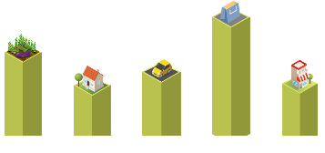
Screen Image of my test results

Slide 7
Areas where I can lessen my footprint
I eat a lot of red meat that accounts to almost all days of the week.
I use a lot of fuel for travelling within a week which is combined by use of private car and motorcycle.
My household produces more waste as compared to my neighbours.
Greatest percentage of the energy that my household consumes is not renewable.

Slide 8
Ways of lessening my carbon footprint
Developing a new vegetarian recipe where I only consume red meat twice a weak instead of consuming it six times a week.
Instead of travelling daily by private car and motor cycle, I shall initiate activities that reduce the amount of fumes emitted when driving by taking walks where distances are manageable and also using bicycle for transport like once a week.

Slide 9
Ways of lessening my carbon footprint
Instead of disposing all waste products, I shall introduce recycling some of the waste produced at the household level so as to reduce the amount of waste that is disposed.
A apart from only using non-renewable energy, I shall incorporate renewable energy in the forms of energy consumed in my household.

Slide 10
How I would achieve the goal of lessening my footprint
I would use public transport to my place of work twice per week. By not driving on these two days in a week, I shall reduce the carbon emissions by 40 lbs per week which amounts to 1920lbs of carbon in a year.
The plastic tins used to pack shopping that my household consumes shall be recycled and be used as storage facilities for various things in the house including water and this shall reduce carbon emissions to the tune of about 500lbs per year.

Slide 11
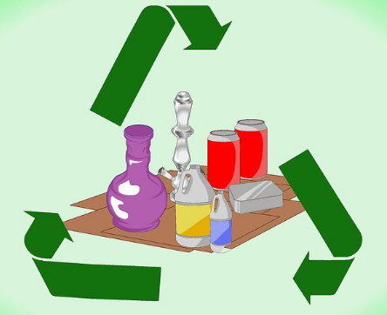
Image demonstrating techniques for reducing my footprint (Goodall, 2017)

Slide 12
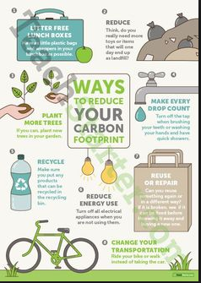
Image demonstrating techniques for reducing my footprint (Goodall, 2017)

Slide 13
Conclusion
Having established that my carbon footprint is 55 tones per year, I developed a program to reduce it.
I have found using of my motor vehicle for transport on a daily basis contributes to the increase of the amount of carbon that is emitted in the atmosphere.
As such, I would include more of public transport in my movements.
Other activities that would reduce carbon emissions in to the atmosphere include use of renewable energy and recycling of wastes.

Slide 14
References
Goodall, C. (2017). How to reduce your carbon footprint: The Gurdian.
Menon, R. (2014). Carbon footprint: Reducing it for a better tomorrow. Place of publication not identified: The Energy And Resources.
Muthu, S. S. (2015). The carbon footprint handbook.
www.footprintcalculator.org.

